Slide 1
Global Bank Admin Management Application
A Java, Spring Boot, MySQL and React JS based CRUD Application.

Slide 2
Contents
Project Overview
Functionalities
Technology Stack
Database Schema
UI and Workflow

Slide 3
Project Overview
The Global Bank application allows admin to log in and performs admin-related activities. This application will allow performing the below operations:
Admin can be able to delete any customer
Admin can be able to add branch details
Admin can be able to delete branch details
Admin can be able to open an account for registered customer
Admin can be able to close an account for registered customers
Display all customers details
Displays all branch related details

Slide 4
Functionalities
A standard login screen to validate admin credentials
Screen for admin operations menu
Screen for display customers details
Screen for Display Branch Details
Screen for admin to add or open customer account
Screen for admin to add or create a branch details
Notes:
A standard login screen to validate admin credentials
Screen for admin operations menu
Screen for display customers details
Screen for Display Branch Details
Screen for admin to add or open customer account
Screen for admin to add or create a branch details

Slide 5






Tech Stack

Slide 6
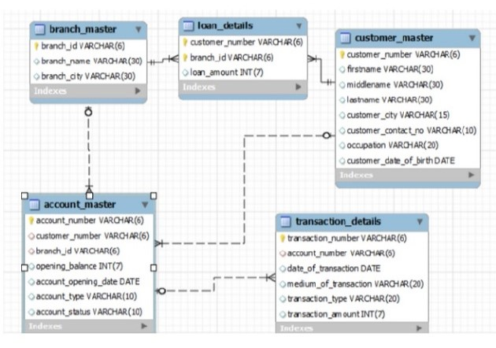
Database Schema

Slide 7

UI and Workflow

Slide 8
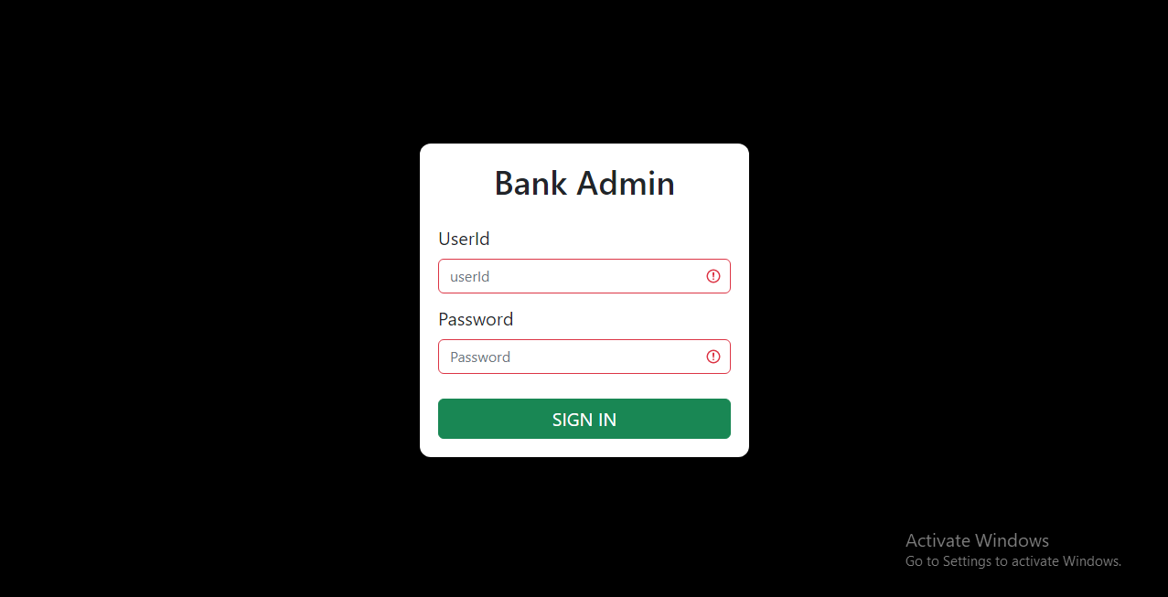
UI and Workflow

Slide 9
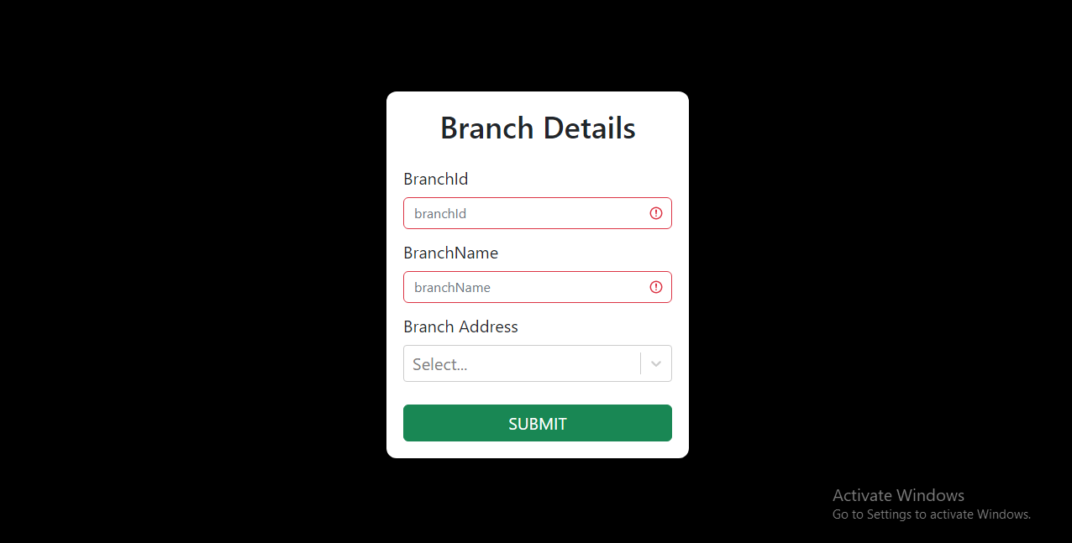
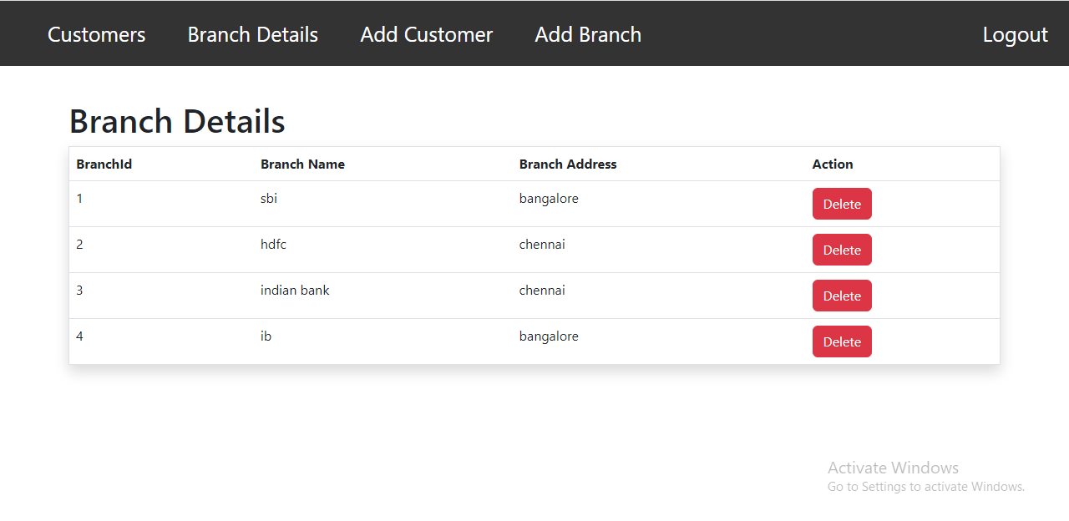
UI and Workflow

Slide 10
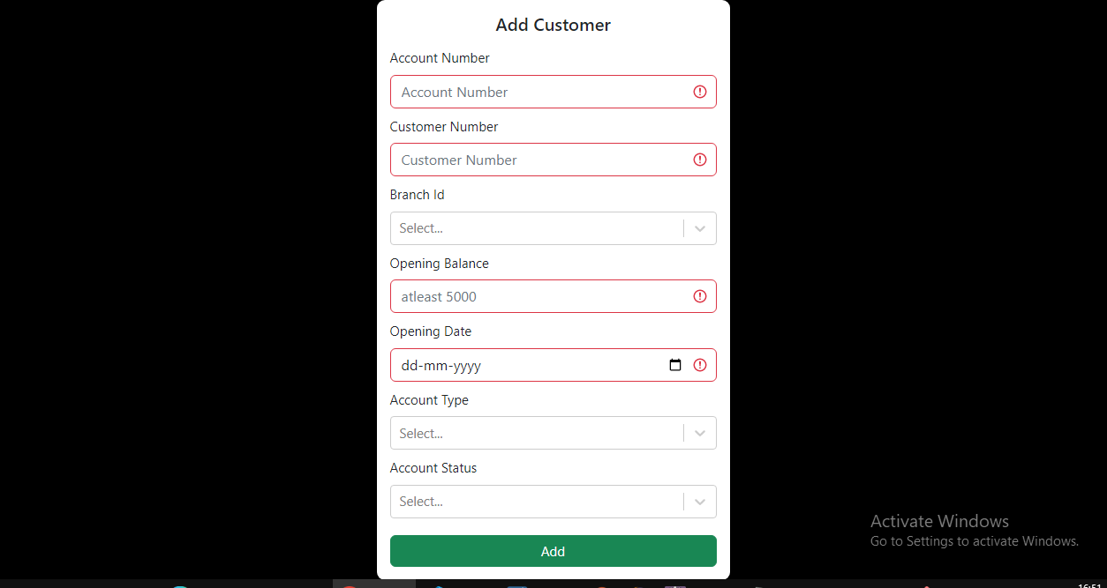
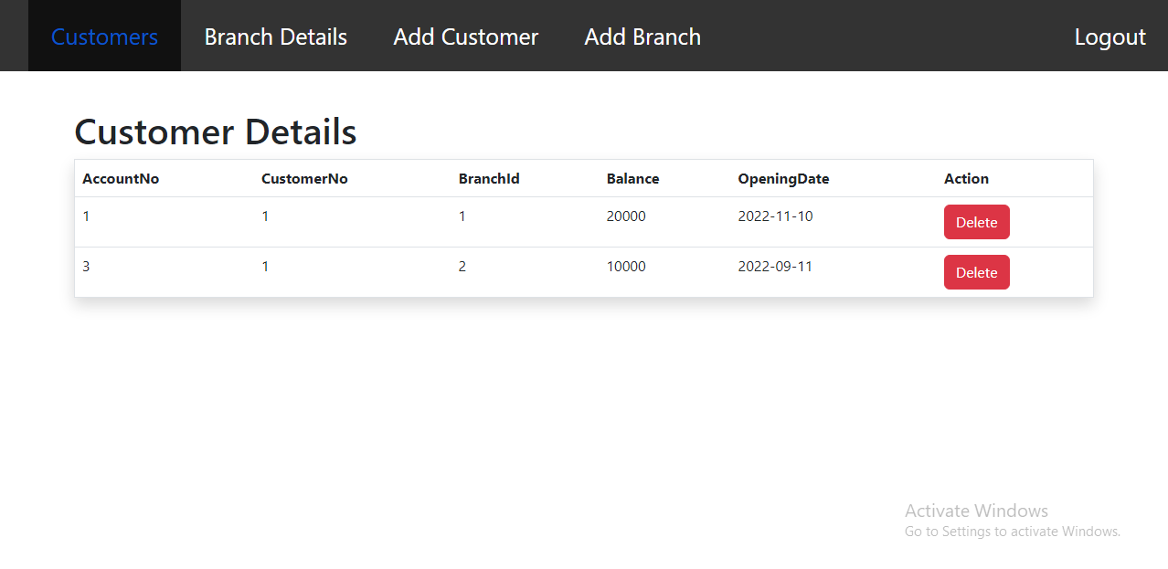
UI and Workflow

Slide 11
Thank you!

